Slide 1
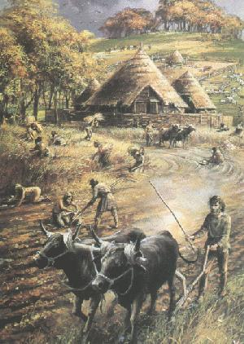
What is culture? Standard 10.1
The word culture, from the Latin colo, -ere, with its root meaning "to cultivate“.
Culture refers to the universal human capacity to classify, and communicate their experiences symbolically.

Slide 2
What is culture? Standard 10.1
Culture - has been called "the way of life for an entire society." As such, it includes codes of manners, dress, language, religion, rituals, norms of behaviors and systems of belief.

Slide 3
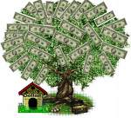
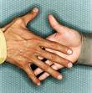
What is culture? Standard 10.1
A common way of understanding culture is to see it as consisting of four elements that are "passed on from generation to generation by learning alone":
values
norms
institutions
Artifacts.

Slide 4
What is culture? Standard 10.1
Values comprise ideas about what in life seems important.
(Fast write) What are the Values in the United States and why?

Slide 5
What is culture? Standard 10.1
Norms consist of expectations of how people will behave in various situations.
(Fast write) What are the norms in the United states?

Slide 6
What is culture? Standard 10.1
Institutions are the structures of a society within which values and norms are transmitted.
Fast write) What institution do you go to daily and show values and social norms?

Slide 7
What is culture? Standard 10.1
Artifacts—things, or aspects of material culture derive from a culture's values and norms.
Fast write) What artifact in your life describes you?

Slide 8
What is culture? Standard 10.1
Subcultures,
Melting Pot:
Multiculturalism:

Slide 9
This powerpoint was kindly donated to www.worldofteaching.com
http://www.worldofteaching.com is home to over a thousand powerpoints submitted by teachers. This is a completely free site and requires no registration. Please visit and I hope it will help in your teaching.

